Slide 1
Android Development Community (ADC)
Kickstart
google.com/+JupiterTecson
https://github.com/jupiterhub

Slide 2
Topics
Now
What is this about?
Why Android
Setup
Theory
Hands-on
Next
App Sharing
App Lessons

Slide 3
What is this about?
Goal for now
Study and show new stuff every week;
Goal for next
Create amazing applications that will make lives better… and a passive income would be good.

Slide 4
Why not Android?
Many form factor. Requires multiple design
Different OEM’s (HTC, LG, Samsung, Sony, etc.)
Software versions. 80% is running Android ICS

Slide 5
Why Android?
Strong language foundation
Mobile, Tablet, Wearables (Glass/Watch), Cars, TV (with controller)
Free / OSS

Slide 6
Activities
Open Discussions
Interaction
Experience
Encourage
Weekly Progress

Slide 7
Setup - Materials
Design Theory / Good Practices
https://developer.android.com/design/index.html
They have topics on Material Design
Practical
https://developer.android.com/training/index.html
Notes:
* Use update site when you have an existing eclipse installation;
* Use bundle when you want to get in the development fast
* Android Studio is still in beta but it will be public soon

Slide 8
Setup - IDE
Eclipse Plugin:
https://dl-ssl.google.com/android/eclipse/
https://developer.android.com/sdk/index.html
Bundle
https://developer.android.com/sdk/index.html
They also have Android Studio (IntelliJ)
Notes:
* Use update site when you have an existing eclipse installation;
* Use bundle when you want to get in the development fast
* Android Studio is still in beta but it will be public soon

Slide 9
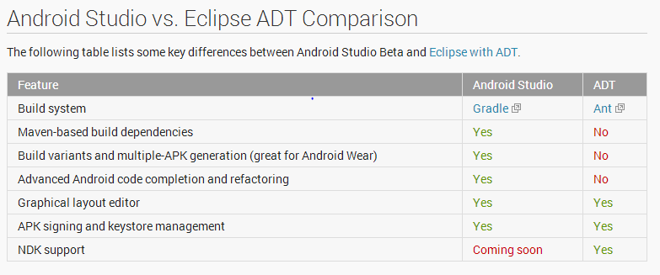
Setup - IDE Comparison
https://developer.android.com/sdk/installing/studio.html

Slide 10
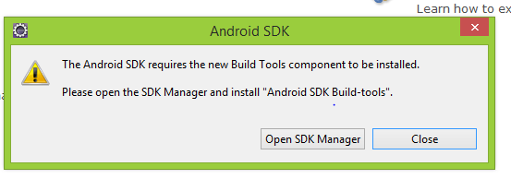
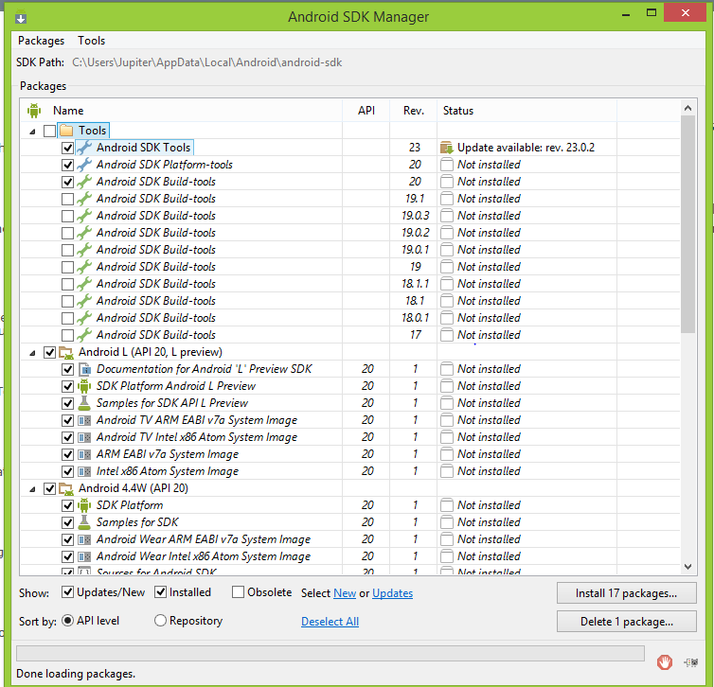
Setup - After Update site

Slide 11
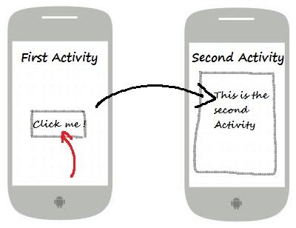
Now - Theory
Activity
http://www.itcsolutions.eu/wp-content/uploads/2011/08/Example_sketch.jpg

Slide 12
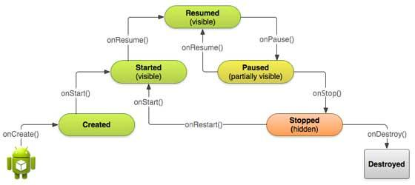
Now - Theory
Activity Lifecycle
http://www.tutorialspoint.com/android/images/android_activity_lifecycle.jpg

Slide 13
Now - Theory
Activity
http://www.itcsolutions.eu/wp-content/uploads/2011/08/Example_sketch.jpg

Slide 14
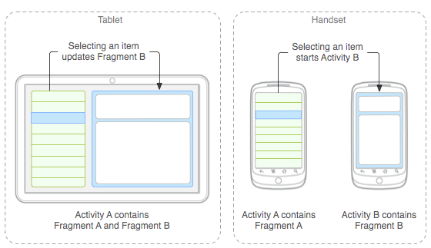
Now - Theory
Fragment
https://developer.android.com/images/fundamentals/fragments.png

Slide 15
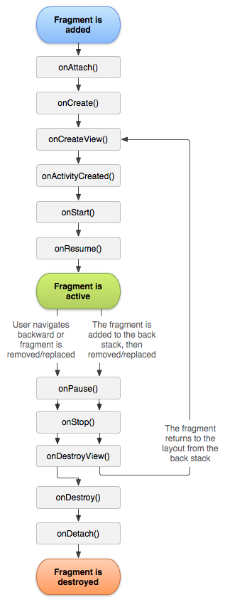
Now - Theory
Fragment Lifecycle
https://developer.android.com/images/fragment_lifecycle.png

Slide 16
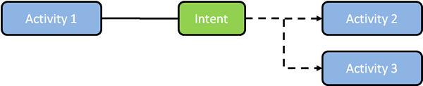
Now - Theory
Intent
https://guardianproject.info/wp-content/uploads/2014/01/Android-Intents.png

Slide 17
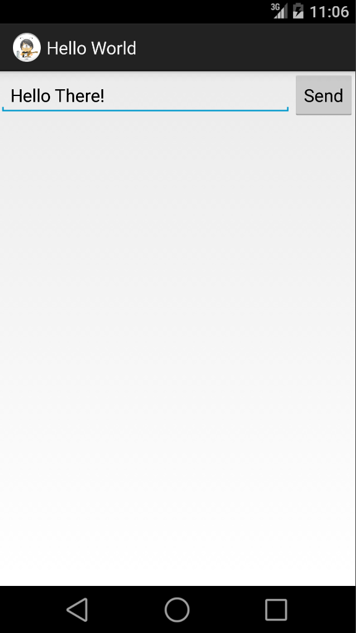
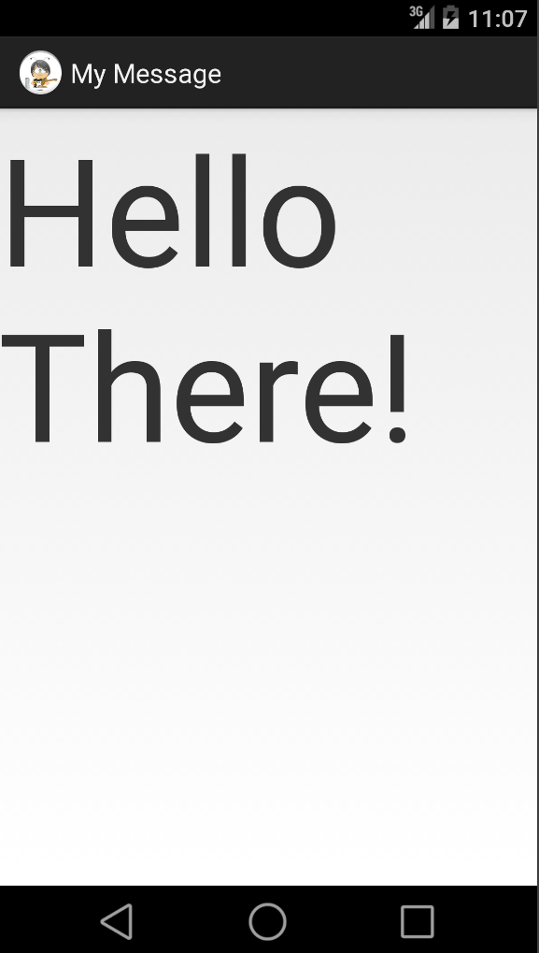
Now - Output

Slide 18
Now - Hands on
Create Hello World
Update Layout
default weight for all views is 0
Add Button
public void actionName(view)

Slide 19
Now - Hands on
Add Intent
explicit intent
Add Another Activity with Fragment
Manifest
https://developer.android.com/guide/components/fragments.html

Slide 20
Now - Hands on
https://developer.android.com/training/basics/firstapp/creating-project.html
Concise documentation

Slide 21
Next - App Sharing
Alec
Fukuma
Jupi
Sara

Slide 22
Next - App Lessons
Alec
Fukuma
Jupi
Sara

